Slide 1
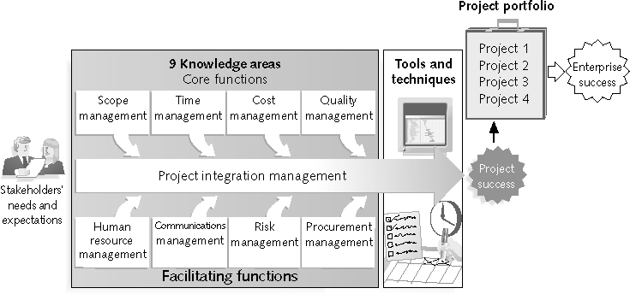
The Key to Overall Project Success: Good Project Integration Management
coordinate all of the other knowledge areas throughout the project’s life cycle
Look at big picture not details

Slide 2
Project Integration Management Processes
Develop the project charter:
working with stakeholders to create the document that formally authorizes a project—the charter
Develop the project management plan:
coordinating all planning efforts to create a consistent, coherent document—the project management plan
Direct and manage project execution:
carrying out the project management plan by performing the activities included in it

Slide 3
Project Integration Management Processes (continued)
Monitor and control the project work:
overseeing project work to meet the performance objectives of the project
Perform integrated change control:
coordinating changes that affect the project’s deliverables and organizational process assets
Close the project or phase:
finalizing all project activities to formally close the project or phase

Slide 4
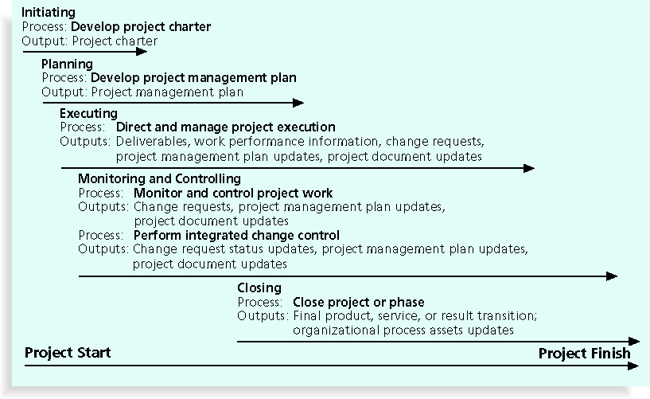
Project Integration Management Summary
Compare to PMBOK 2008 pg. 73

Slide 5

What Went Wrong?
The Airbus A380 megajet project was two years behind schedule in Oct. 2006, causing Airbus’ parent company to face an expected loss of $6.1 billion over the next four years

Slide 6
What Went Wrong?
The Airbus A380 megajet project was two years behind schedule in Oct. 2006, causing Airbus’ parent company to face an expected loss of $6.1 billion over the next four years
The project suffered from severe integration management problems, or “integration disintegration...Early this year, when pre-assembled bundles containing hundreds of miles of cabin wiring were delivered from a German factory to the assembly line in France, workers discovered that the bundles, called harnesses, didn't fit properly into the plane. Assembly slowed to a near-standstill, as workers tried to pull the bundles apart and re-thread them through the fuselage. Now Airbus will have to go back to the drawing board and redesign the wiring system.”*
*Matlack, Carol. “First, Blame the Software,” BusinessWeek Online (October 5, 2006).

Slide 7
Strategic Planning and Project Selection
Strategic planning involves determining long-term objectives, predicting future trends, and projecting the need for new products and services
Organizations often perform a SWOT analysis
Analyzing Strengths, Weaknesses, Opportunities, and Threats
As part of strategic planning, organizations:
Identify potential projects
Use realistic methods to select which projects to work on
Formalize project initiation by issuing a project charter

Slide 8
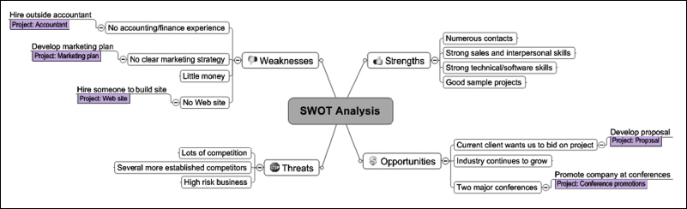
Mind Map of a SWOT Analysis to Help Identify Potential Projects

Slide 9
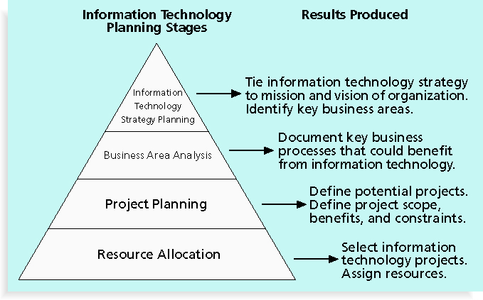
Technology Planning Process

Slide 10
Methods for Selecting Projects
There are usually more projects than available time and resources to implement them
Methods for selecting projects include:
1. Focusing on broad organizational needs
2. Categorizing technology projects
3. Performing net present value or other financial analyses
4. Using a weighted scoring model

Slide 11
1. Methods for Selecting Projects - Focusing on Broad Organizational Needs
It is often difficult to provide strong justification for many technology projects, but everyone agrees they have a high value
Three important criteria for projects:
There is a need for the project
There are funds available
There’s a strong will to make the project succeed

Slide 12
2. Methods for Selecting Projects - Categorizing IT Projects
One categorization is whether the project addresses:
A problem
An opportunity, or
A directive
how long it will take to do the project
priority of the project

Slide 13
3. Methods for Selecting Projects - Financial Analysis of Projects
Financial considerations are often an important consideration in selecting projects
Three primary methods for determining the projected financial value of projects:
Net present value (NPV) analysis
Return on investment (ROI)
Payback analysis

Slide 14
4. Weighted Scoring Model
A weighted scoring model is a tool that provides a systematic process for selecting projects based on many criteria:
Identify criteria important to the project selection process
Assign weights (percentages) to each criterion so they add up to 100%
Assign scores to each criterion for each project
Multiply the scores by the weights and get the total weighted scores
The higher the weighted score, the better

Slide 15
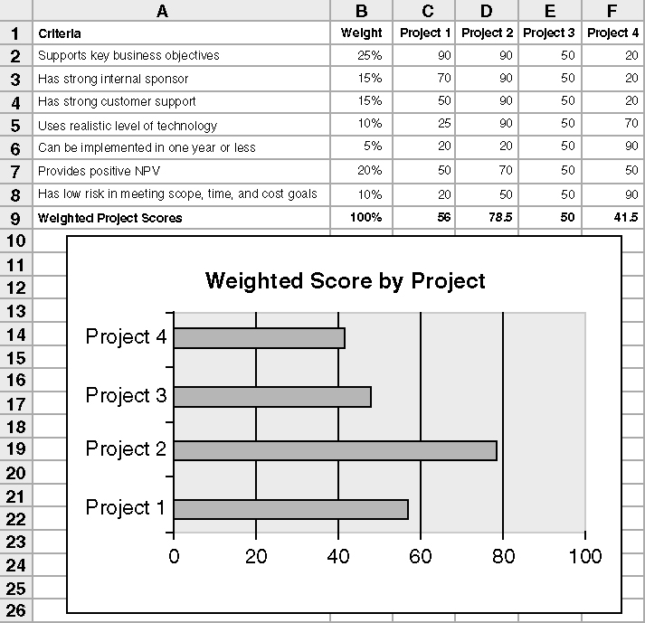
Weighted Scoring Model for Project Selection

Slide 16
Project Charter
After deciding what project to work on, it is important to all stakeholders
A project charter is a document that formally recognizes the existence of a project and provides direction on the project’s objectives and management
Key project stakeholders should sign a project charter to acknowledge agreement on the need and intent of the project; a signed charter is a key output of project integration management

Slide 17
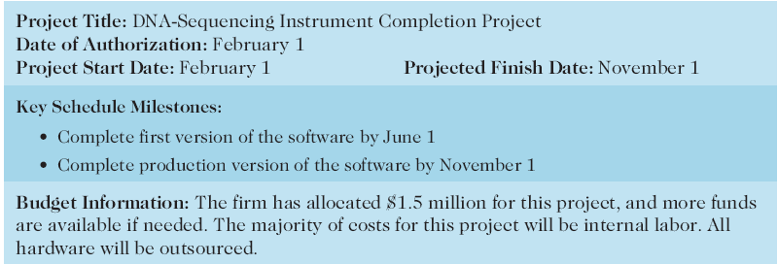
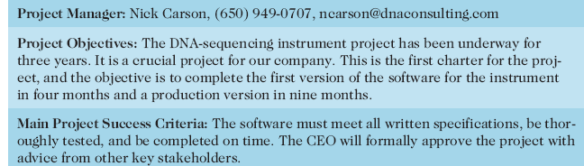
Project Charter for the DNA-Sequencing Instrument Completion Project

Slide 18
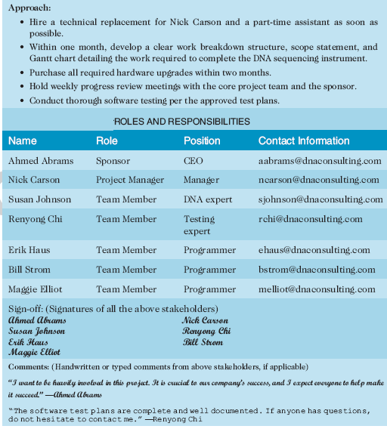
Charter (continued)

Slide 19
Project Management Plans
A project management plan is a document used to coordinate all project planning documents and help guide a project’s execution and control
Plans created in the other knowledge areas are subsidiary parts of the overall project management plan

Slide 20
Common Elements of a Project Management Plan
Introduction or overview of the project
Description of how the project is organized
Management and technical processes used on the project
Work to be done, schedule, and budget information

Slide 21
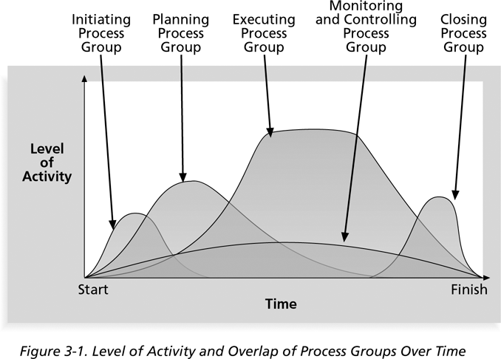
Project Execution
Project execution involves managing and performing the work described in the project management plan
The majority of time and money is usually spent on execution

Slide 22
Coordinating Planning and Execution
Project planning and execution are intertwined and inseparable activities
Those who will do the work should help to plan the work
Project managers must solicit input from the team to develop realistic plans

Slide 23
Providing Leadership and a Supportive Culture - execution
Project managers must lead by example to demonstrate the importance of creating and then following good project plans
Organizational culture can help project execution by:
Providing guidelines and templates
Tracking performance based on plans
Project managers may still need to break the rules to meet project goals, and senior managers must support those actions

Slide 24
Important Skills for Project Execution
General management skills like leadership, communication, and political skills
Product, business, and application area skills and knowledge
Use of specialized tools and techniques

Slide 25
Project Execution Tools and Techniques
Expert judgment: (Delphi Technique) experts can help project managers and their teams make many decisions related to project execution
Project management information systems

Slide 26
Monitoring and Controlling Project Work
Monitoring project work includes
Collecting
Measuring
disseminating performance information
A baseline is the approved project management plan plus approved changes

Slide 27
Media Snapshot –Monitor & Control
The 2002 Olympic Winter Games and Paralympics took five years to plan and cost more than $1.9 billion. PMI awarded the Salt Lake Organizing Committee (SLOC) the Project of the Year award for delivering world-class games.
Four years before the Games began, the SLOC used a Primavera software-based system with a cascading color-coded WBS to integrate planning…The SLOC also used an Executive Roadmap, a one-page list of the top 100 Games-wide activities, to keep executives apprised of progress. Activities were tied to detailed project information within each department’s schedule. A 90-day highlighter showed which managers were accountable for each integrated activity.
Fraser Bullock, SLOC Chief Operating Officer and Chief, said, “We knew when we were on and off schedule and where we had to apply additional resources. The interrelation of the functions meant they could not run in isolation—it was a smoothly running machine.”*

Slide 28
Integrated Change Control
Three main objectives are:
Determining that a change has occurred
Managing actual changes as they occur

Slide 29
Change Control System
A formal, documented process that describes when and how official project documents and work may be changed Change Control Board (CCB)
Describes who is authorized to make changes and how to make them

Slide 30
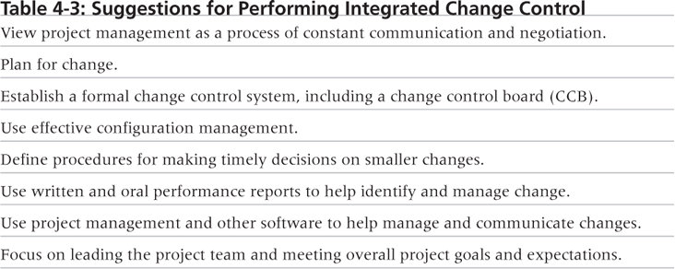
Suggestions for Performing Integrated Change Control

Slide 31
Closing Projects and Phases
To close a project or phase, you must finalize all activities and transfer the completed or cancelled work to the appropriate people in operations
Main outputs include:
Final product, service, or result transition (OAC)
Organizational process asset updates

Slide 32
Chapter Summary
Project integration management involves coordinating all of the other knowledge areas throughout a project’s life cycle
Main processes include:
Develop project charter
Develop project management plan
Direct and manage project execution
Monitor and control project work
Perform integrated change control
Close the project or phase

